Slide 1

Board Engagement Support – Next Steps
All webinar attendees will have access to today’s slides and recording and can use it to educate their Boards and key staff, e.g., finance, strategy, & program staff
Inclusive Alliance member organizations have access to support from IPA staff to prepare a tailored Board presentation, including limited access to expertise from M.S. Hall + Associates

Slide 2
What is Inclusive Alliance doing to prepare our region for the SDHN?
Monthly 1115 educational webinar series
Social Determinants of Health Co-Design Process
  Fall CBO Listening Sessions w/ M.S. Hall + Associates → understand the current state of the human service delivery system (co-sensing)
  Winter key informant interviews → supplement understanding of the current state of the human service delivery system (co-sensing)
  Spring CBO Co-Design Sessions w/ M.S. Hall + Associates → how do we want to leverage the SDHN funding opportunity for the benefit of the community, given the limitations of the program & funding requirements?
Regional SDOH Inventory

Slide 3
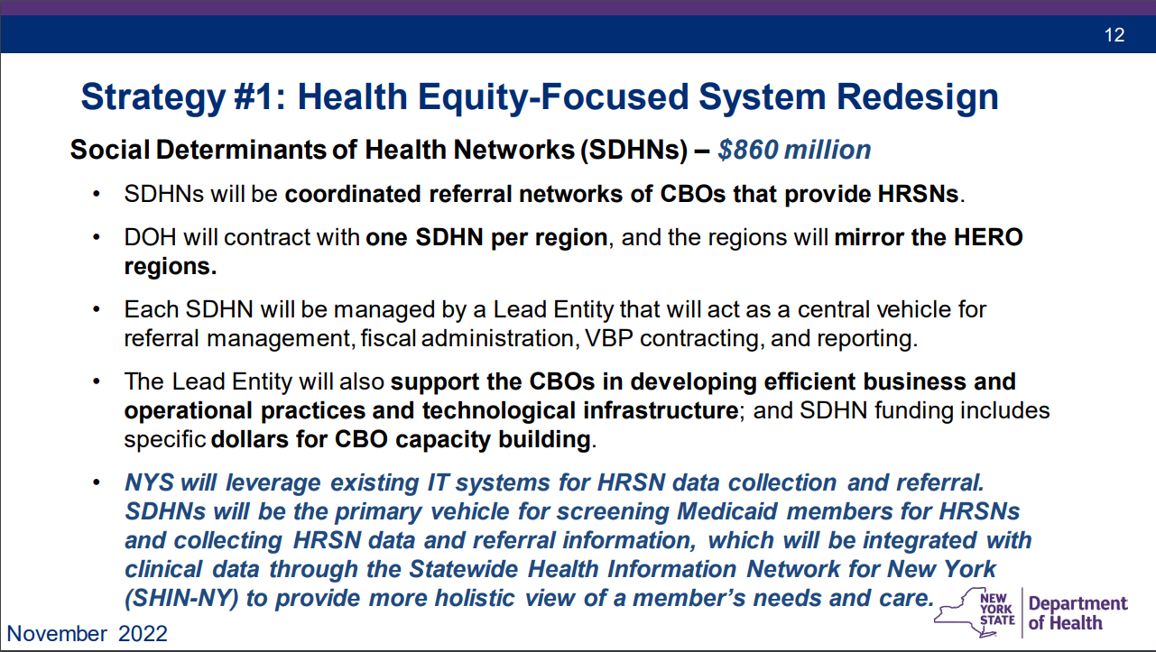
How is Inclusive Alliance qualified to lead a SDHN application?
Non-profit IPA structure for contracting
Experience with Unite Us
Business intelligence infrastructure
CBO-lead, representative governance structure
Purpose is to prepare our members for VBP
CBO capacity building & contracting opportunities has been our strategic direction for years and will continue even without 1115

